Slide 2
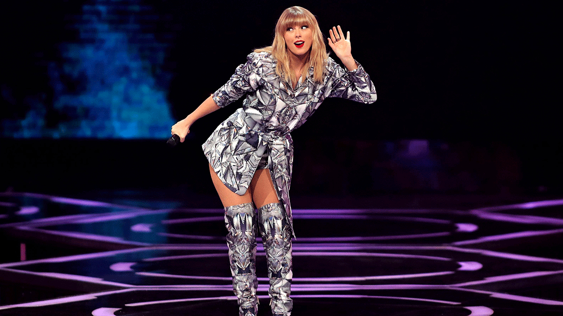

Slide 3
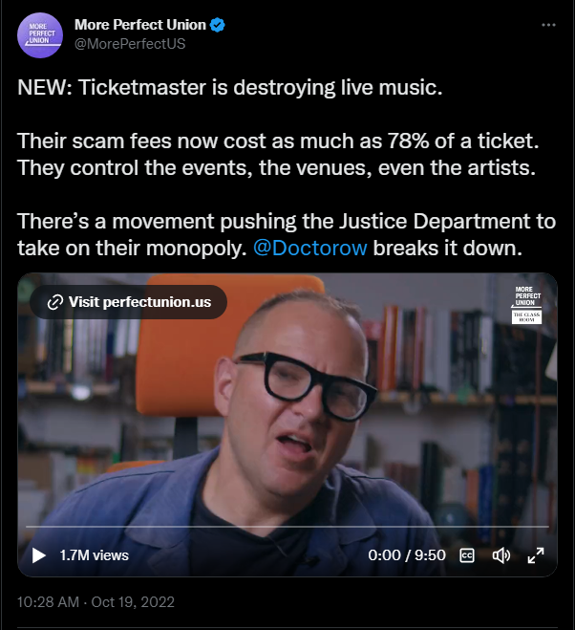
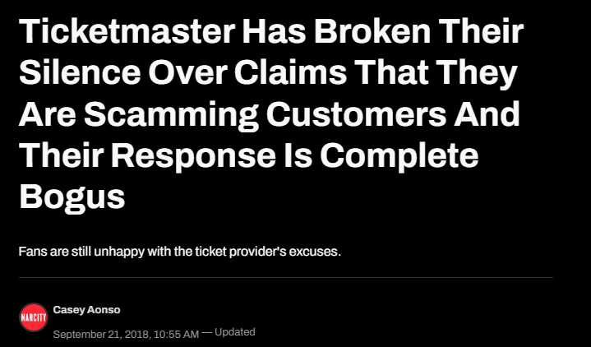
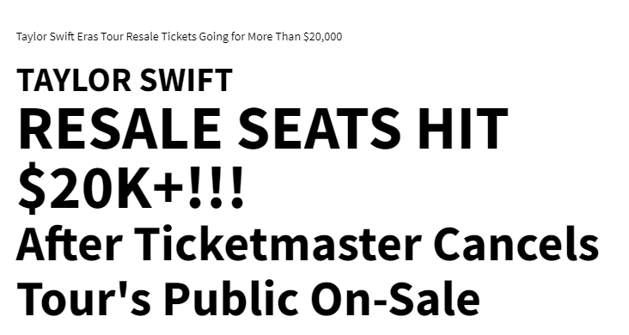
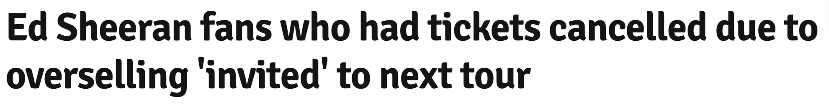
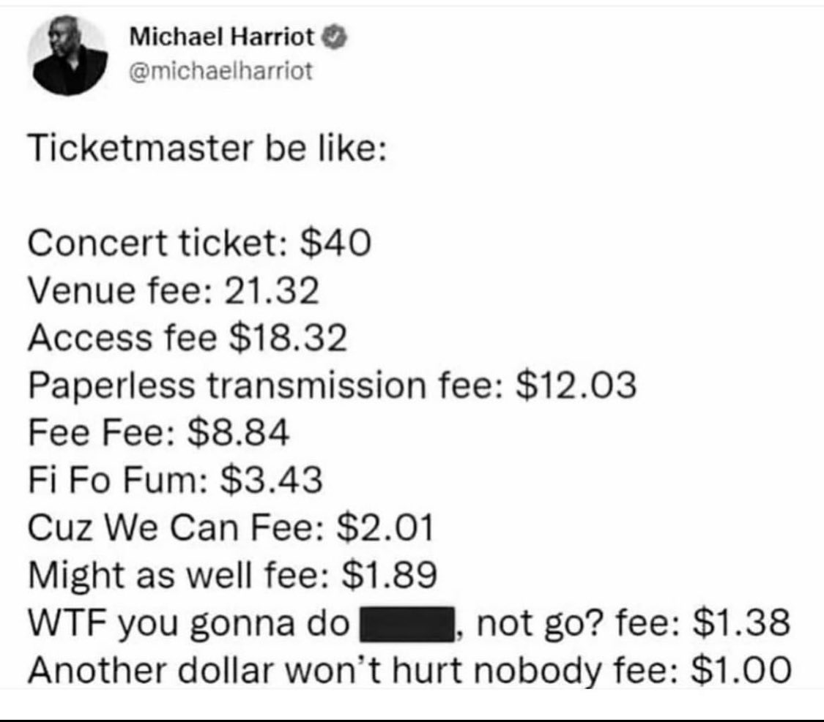
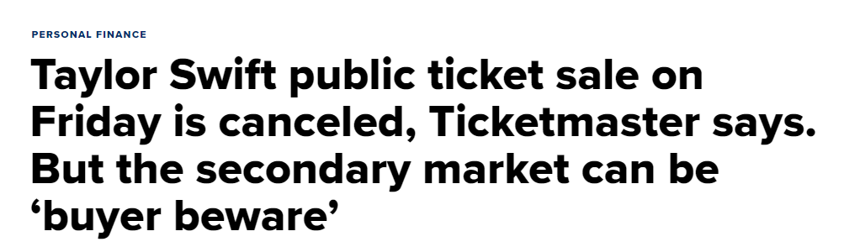
Another idea, equally important
2023
CHAINTIX

Slide 4


Another idea, equally important
The Problem
Problem
Lack of transparency
Lack of trust
Negatives
Scalping
Over Subscribe
2023
CHAINTIX

Slide 5


Who is impacted by this problem?
The stakeholder
The consumer
The platform
2023
CHAINTIX

Slide 6

THE SOLUTION

Slide 7


Slide 8
Revolutionizing event ticketing with decentralized, secure, and transparent technology powered by Polygon blockchain.
It's Your Event and Your Customer

Slide 9
Another idea, equally important
How the problem attempted to be solved before:
Competitors:
EventChain
TixoLogy
Solved Counterfeit Tickets problem,
Made Purchase Transparent,
But…
Didn't solve the Scalping Problem
Didn't solve Overselling Problem
2023
CHAINTIX

Slide 10

Another idea, equally important
Solution
Blockchain for Transparency
Smart Contract to avoid overselling
Soulbound Token for preventing scalping
2023
CHAINTIX

Slide 11



What is SBT?
EIP-5516
NFT but…
Non-transferable
Revoke Ability
Based on:
https://vitalik.ca/general/2022/01/26/soulbound.html
Decentralized Society: Finding Web3’s Soul 1
2023
CHAINTIX

Slide 12

Customizable SBT to issue event tickets
2023
CHAINTIX

Slide 13
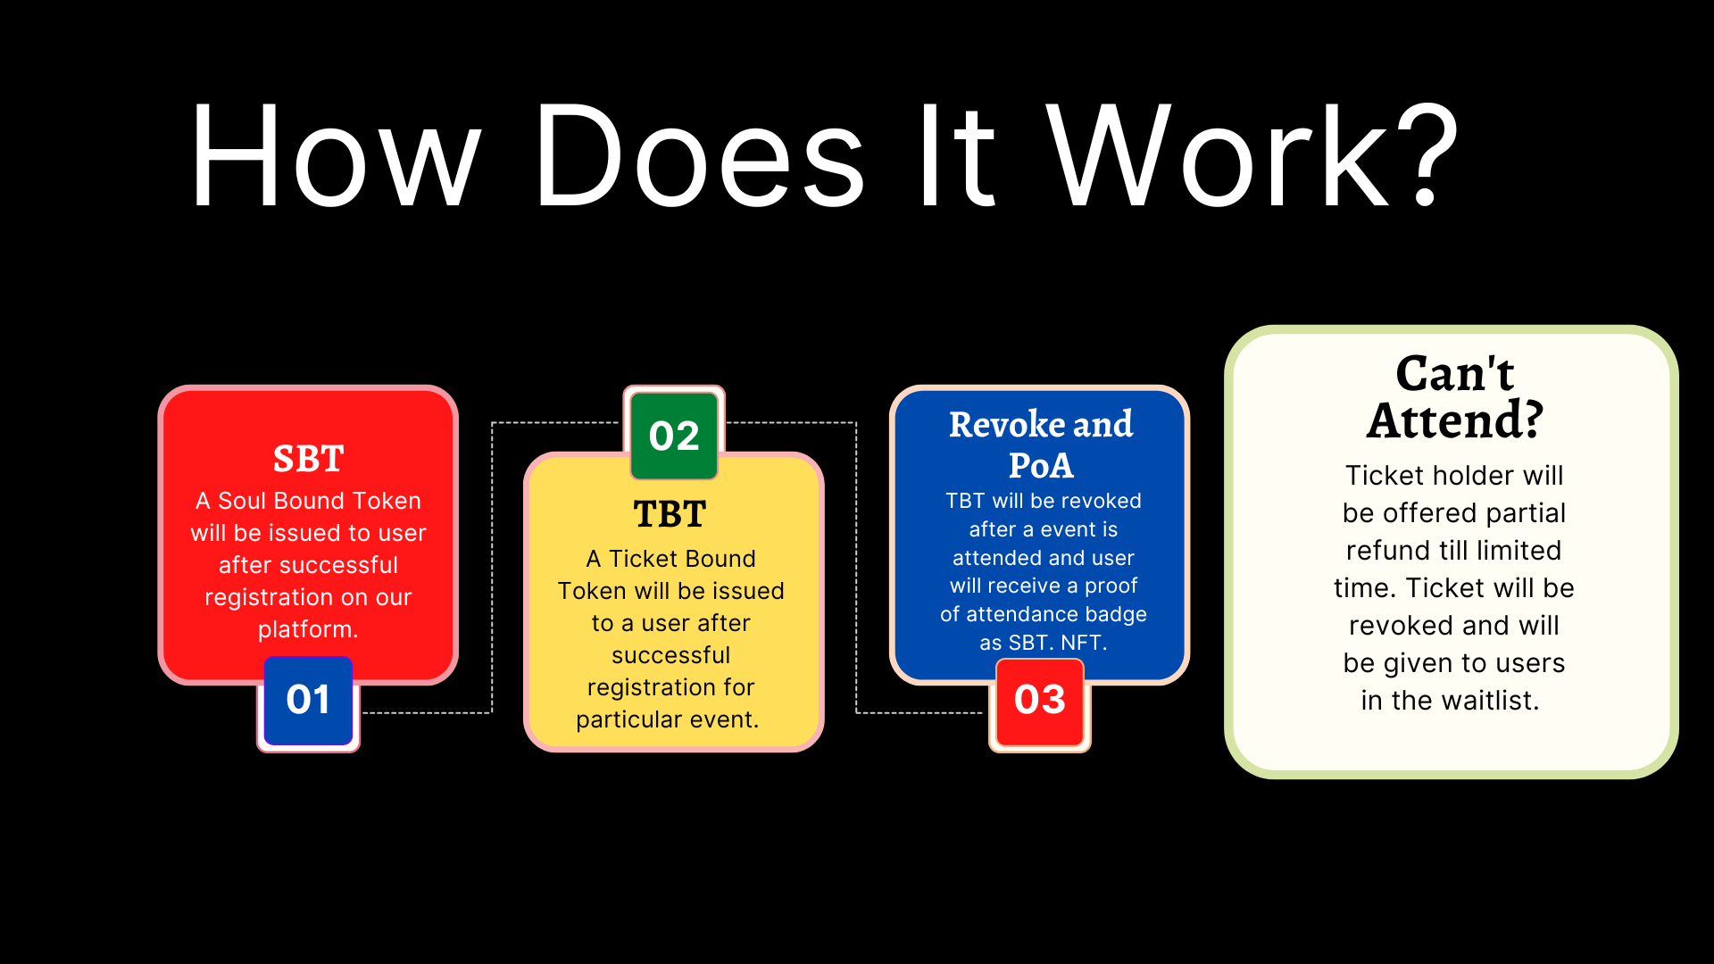
2024
COMPANY NAME

Slide 14
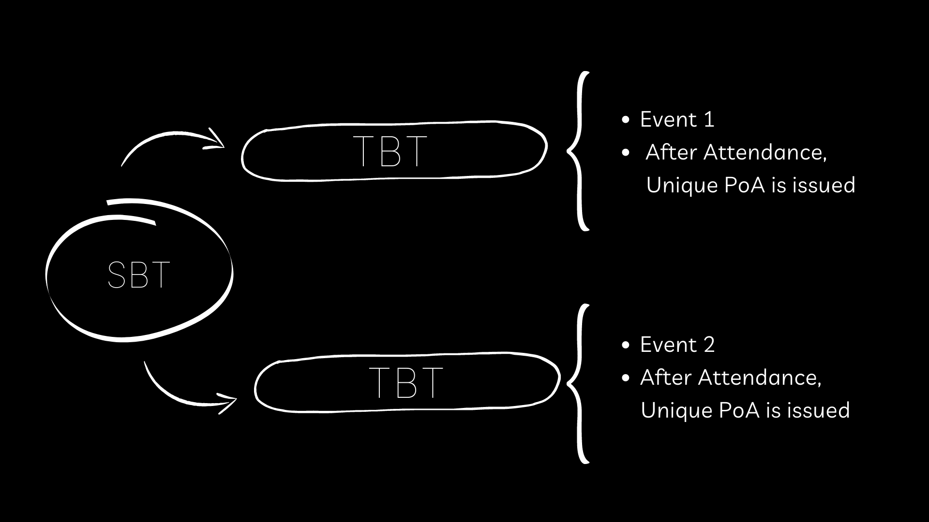
Another idea, equally important
Token mapping between SBT and TBT.
2023
CHAINTIX

Slide 15
PLATFORM FEATURES
Deploy on polygon
Support for multiple payment methods
DAO for dispute resolution
Attendees can review events and artists
Integrate Proof of Humanity protocol
Ticket cancellation support
Proof of attendance
Native coin with added perks

Slide 16
CHAINTIX TOKEN (CTIX)

Slide 17
$CTIX PERKS
Early bird tickets
Priority seating
Discounted pricing
Perks for CTIX stakers:
Ticket/Token airdrop
Waitlist priority
Less cancellation charges

Slide 18
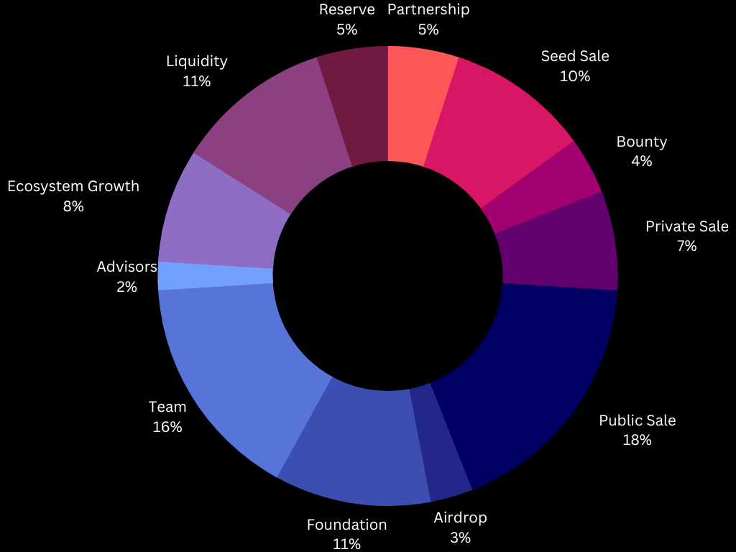
CTIX TOKENOMICS
Total Supply
100M

Slide 19
CTIX VESTING SCHDULE
Category | Total Amount | Distributed at TGE | Cliff | Vesting
Seed Sale | 10,000,000 | 10.0% | 1 month | 9 months
Private Sale | 7,000,000 | 10.0% | 1 month | 6 month
Public Sale | 18,000,000 | 50.0% | - | 1 month
Reserve | 5,000,000 | 0.0% | 12 months | -
Liquidity | 11,000,000 | 15% | - | 18 months
Airdrop | 3,000,000 | 0.0% | 12 months | 6 months
Bounty | 4,000,000 | 100.0% | - | -
Ecosystem Growth | 8,000,000 | 2.5% | - | 18 months
Foundation | 11,000,000 | 0.0% | 12 months | 24 months
Team | 16,000,000 | 0.0% | 12 months | 36 months
Advisors | 2,000,000 | 0.0% | 12 months | 12 months
Partnerships | 5,000,000 | 10.0% | 3 months | 18 months

Slide 20
REVENUE MODEL
Event registration fees
Ticket sales
Sponsorship and advertising
Commission on ticket cancellation
Strategic partnerships
Merchandise sales
2023
CHAINTIX

Slide 21
LIVE DEMO

